Slide 1
Does Involvement With R&D Expenditure Contribute to Company’s gross Margin, In Sector Wise?
Only Some Insights are Drawn here, but Could be Drawn many of them with the Visualization

Slide 2
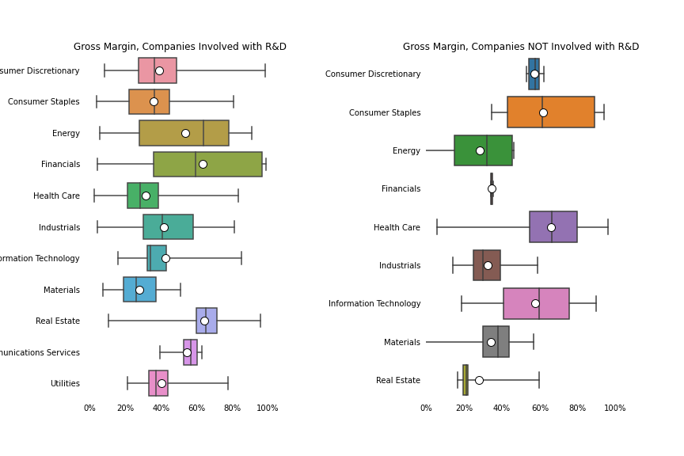
Incurring R&D Expenditure Contribute to the Sector?
<visualization or summary statistics used for finding>
Here Is the Brief Summary of the Distribution of Gross Margin of 2 datasets, one with R&D involvement, Other with not!
Consumer Discretionary has Higher Range of Gross margin Threshold, For Example, mean with 39% and median 36%, and 75th to 100th percentile Population in 45% to 85% Gross margin there are some of The outliers too, achieving more than 80%, with the Range in between 90%, Whereas That without R&D involvement, has a Compact Distribution, with mean and median 57%, all 25th to 75th population managed to achieve 45% to 55%, with Range of 9%.
R&D | NON R&D
Material mean 39% | Mean 57%
Range 90% | Range 9%

Slide 3
How Much R&D Contribute to Energy Sector?
Box Plot of Sectors with R&D or Without
Energy Sector Effectiveness with the R&D expenditure?
With R&D expense, the Distribution of Energy is slightly left–skewed, with a mean of 54% and median of 64%, and the Range of 86%.
Whereas, Energy Sector without R&D Involvement, slightly – left-skewed as well, with a mean of 28%, median of 38%, along with the , which is quite less than Earning capacity of Energy sector With R&D.
Some of the outliers in without R&D Expense earning Negative, along with range of 47%
In Conclusion, R&D seems to be particularly effective in Energy Sector to help the firms to expand the Gross margin Threshold.

Slide 4
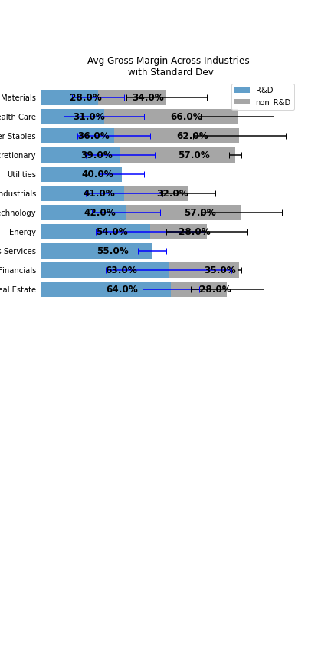
R&D Contribution To Across Industries?
Involving with R&D in Real Estate Business Shows significant higher Average Gross Margin than that of Non-Involvement with R&D, which is 64% and 28%, but The Standard Deviation with Black Mark or Dispersion is lower in Real – State with R&D,14% , with R&D than with Non-R&D’s Standard Deviation of 18%. But Range is lower in, without R&D, which is 43%, Compared to With R&D of 85%. Due to the Outliers of Real State of R&D.
It seems, Industrials with R&D have a higher Gross margin 41%, compared to non R&D of 32%, but Their Variability is High as well, std of 19% than that of 13% with NON-R&D of that Sector, Which Makes the Sector less Consistent or Robust, where the R&D in Real – State Make the COST or REVENUE Consistent or less of dispersion, Which can be thought of a stabilized Sector!
But range still affected by the outliers, with R&D industries is 77%, compared to non_R&D of 45%.

Slide 5
R&D Contribution to Across Industries?
The same Can be said against Materials too, with a lower mean of 28% than 34%, but with a lower STD of 13%, wherewith a higher dispersion of 20% without R&D, which makes the revenue or gross margin less Consistent. And Range of R&D with Materials is 44%, compared to 136% of the non_r&D material sector.
But consumer discretionary with R&D seems like a Failure or no contribution on Gross margin, as the Mean is lower than 39%, along with a higher STD of 17%, compared to 3%, which makes it not preferable
Finance and Energy Care are particularly Effective with R&D Expense, contributing to higher mean Gross Margin, with the Lower Dispersion, which makes the R&D worthwhile.

